Slide 1
Search Intelligence
Discover how you perform in search vs your competition
September 2024

Slide 2
Every Search is a real person raising their hand and asking for help.
Each one is an opportunity to reach, engage and convert them.

Slide 3
With Search Intelligence you’ll discover:
1
2
3
4
What is your audience searching for
What is the size of the search opportunity?
How do you perform in search vs competitors?
How can you boost search performance?
Build out a detailed keyword set mapping out the relevant terms your audience searches for in every stage of customer journey
How many searches are carried out for your keywords and how much traffic could search be driving to your site
How much of the available search traffic are you currently getting? How do you perform in paid and organic search vs your key competitors?
What do you need to do to maximise your paid and organic search performances
Search Intelligence | 3

Slide 4





1. What is your audience searching for?
Bespoke keyword research covering all the moments that matter.
DISCOVER
Highly relevant, top-of-the-funnel informational searches likely to precede product search.
EXPLORE
Category-specific searches in the early stages of the research phase.
CHOOSE
Detailed searches carried out as users select the best product to meet their needs.
PURCHASE
Brand keywords where people have chosen what product they want and are ready to buy.
POST-PURCHASE
Branded informational terms from customers who have already purchased.

Slide 5
2. What is the size of the search opportunity?
How much do people search in each stage of the customer journey
Which platforms are your audience searching in most?
How much traffic could search deliver?
How much of that potential traffic are you currently getting from organic and paid search
Search Intelligence | 5

Slide 6
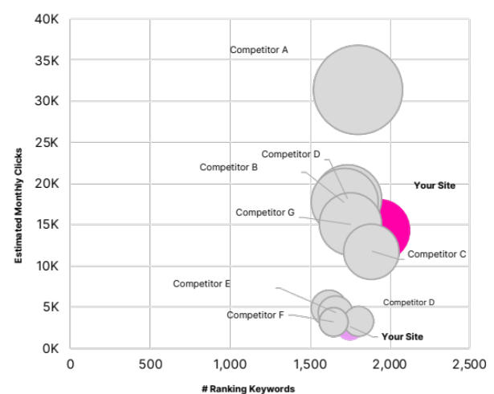
3. How do you perform in search vs your competitors?
See how you stack up in search against other brands and sites
Organic search performance vs competitors through the funnel
Benchmarked PPC spend analysis
How much PPC budget could you free up with Equilibrium?
Benchmarked Organic Search Performance
Benchmarked Paid Search Spend
Equilibrium Holistic Search Recommendations
Keyword | PPC Comp. | Organic Rank | Equilibrium Action
xxxxx xxx | 0 | 1 | Pause
xxx xxxx xxxxxx | 2 | 101 | Enable
xxxxxxx xxxx | 6 | 68 | Enable
xxxxx xxx | 4 | 1 | Enable
xxx xxxx xxxxxx | 4 | 2 | Enable
xxxxxxx xxxx | 3 | 79 | Enable
xxxxxxx xxxx | 0 | 1 | Pause
xxxxx xxx | 0 | 1 | Pause
xxx xxxx xxxxxx | 0 | 1 | Pause
xxxxxxx xxxx | 0 | 1 | Pause
Your site
Competitor G
Discover how much PPC budget could be freed up to reinvest by integrating Paid & Organic search.
Our Equilibrium tool automatically makes PPC bid adjustments across your keyword set in real time based on organic performance and competitor activity – eg pausing spend on keywords with P1 organic ranking when no competitor PPC activity is live.
Competitor A
Competitor C
Competitor F
Competitor B
Competitor E
Competitor D
Find out how your site performs in organic search for all relevant keywords, in every stage of the consumer story.
Identify the type of sites which perform best, the type of content which is most effective and understand your ‘right to rank’ organically.
Find out how much competitors are spending in paid search across your target keywords, by journey stage.
Search Intelligence | 6

Slide 7

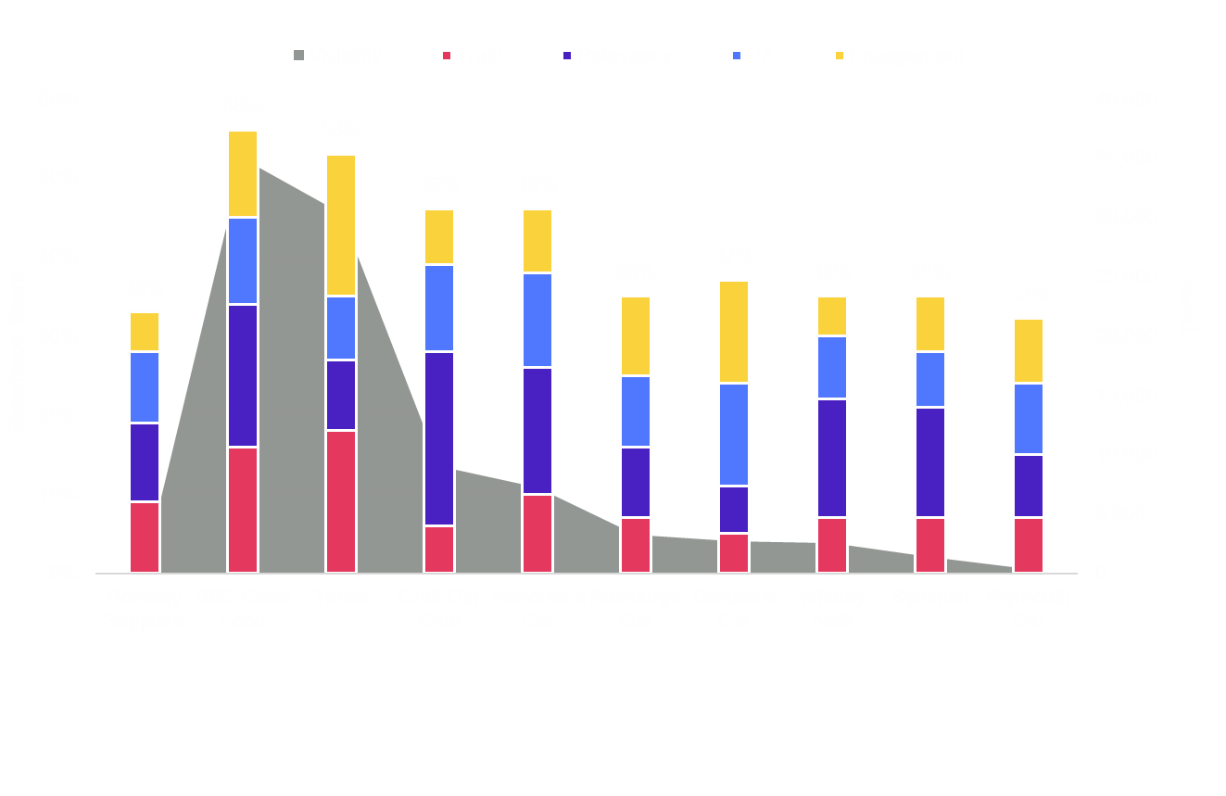
4. How can you boost your search performance?
Discover what you need to do to maximise performance from search
Tech Fundamentals
Experience Essentials
Paid Search Landscape
How well is your site set up for organic search?
How proficient is your digital experience?
How well do you have the PPC market covered?
Competitor A
Your brand
Competitor B
Understand where your site has optimisation gaps vs best practice – and your competitors.
Discover where to focus your SEO efforts – do you need to boost trust signals, content relevancy, user experience or engagement? Or is it a blend of all four.
Get unparalleled insights into competitor PPC activity and effectiveness – what keywords are the focusing on, how aggressive is their approach, how much traffic are they driving?
Search Intelligence | 7

Slide 8
Search Intelligence Key Deliverables
Keyword Research & Categorisation
Paid & Organic Search Landscaping
Organic Search Proficiency Analysis
Search Equilibrium Analysis
Search Forecast & Recommendations
A detailed bespoke keyword set identifying relevant search terms across your audience’s consumer journey.
Categorised by journey stage, brand vs non brand, topic area etc.
Includes monthly average search volume…
Detailed analysis of the paid and organic search opportunity at each stage of the customer journey.A
Includes competitor benchmarking across paid and organic search, covering search visibility/rankings and estimated PPC spend.
In-depth analysis of your organic search proficiency using our proprietary Flow Experience Audit toolset.
Provides benchmarked assessment of SEO Technical Fundamentals and audit of SEO proficiency across key ranking factors - trust, relevancy, UX & engagement.
Analysis of your holistic search performance across paid and organic.
Includes analysis of potential PPC efficiencies to be gained based on a snapshot of SEO & PPC activity over a one-week period.
High-level recommendations to improve paid and organic search performance based on all our insight and analysis.
Includes high-level organic traffic forecast setting out what SEO could deliver over 24 months.
Format: Excel + PPT Summary
Format: PPT/PDF
Format: PPT/PDF
Format: PPT/PDF
Format: PPT/PDF
Total Price: £9,500
COMMERCE COMMUNITY CALL | 8

Slide 9
Start 2025 with a clear view of your search performance
Speak to us today

